Slide 1

AI Robotics and Automation AIDI1012 - 2023 Winter Term Project Jetson NANO Developer Kit
A2 Group members:
Shivani Bajaj(200527764)
Cheuk Ying Iu(200514612)
Fangji Chen(200520598)
Ayesha Siddiqa(200502171)
Taekeon Kim(200452564)
Shivansh Setia(200511522)
Harshal Shashikant Bhasgauri(200499159)
Hamza Kadodia(200535827)
Sahil Singal( 200506536)
Himanshu (200535823)

Slide 2
Contents
Jetbot Preparation
Data collection
Jetbot training steps
Jetbot in action: running the training algorithm
Conclusion:
Challenges faced
Resolving Jetbot training issues
Ways to enhance Jetbot training performance

Slide 3

Jetbot Preparation

Slide 4
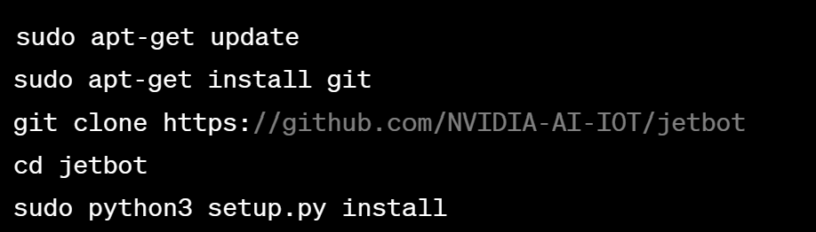
Jetbot Preparation
Setting up the JetBot:
Assemble the JetBot following the instructions provided with the kit.
Connect the JetBot to a power source and a display monitor.
Connect a keyboard and mouse to the JetBot.
Boot up the JetBot and ensure that it's connected to the internet.
Setting up the development environment:
Open a terminal window on the JetBot and run the following commands:
This will install the necessary packages and libraries for running the JetBot.

Slide 5
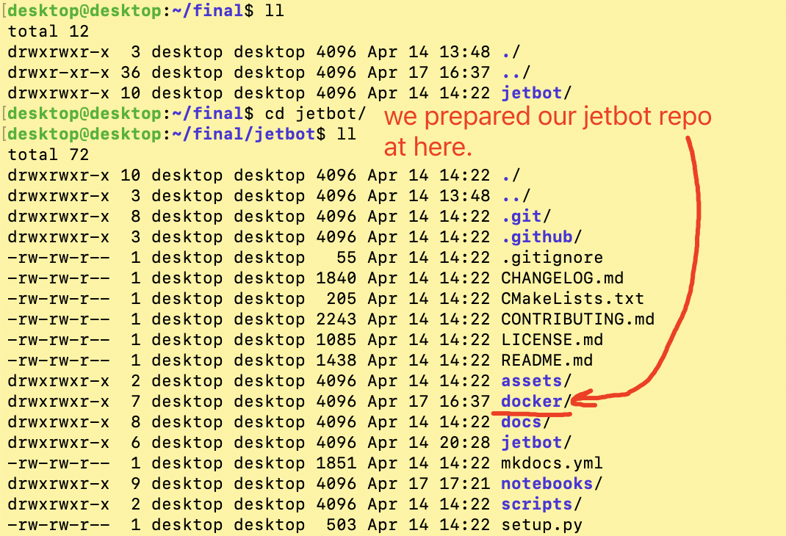

Slide 6
Data Collection

Slide 7
Data Collection
Connecting the CSI MIPI Camera to the JetBot: Connecting a CSI MIPI camera to the JetBot involves physically attaching the camera module to the JetBot camera port. The CSI MIPI camera uses a high-speed serial interface to connect directly to the Jetson Nano module on the JetBot. Once connected, the Jetson Nano can access the video feed from the camera to perform various image processing tasks.
Displaying the Live Image Feed and Annotating Data: To display the live image feed from the camera, you can run the provided code on the JetBot. This code uses the camera interface library in Python to capture frames from the camera and display them on the JetBot screen. Additionally, the code enables the jupyter_clickable_image_widget, which allows you to click on the live image feed to annotate data with the x and y pixel coordinates of the object of interest. This is useful for tasks such as object detection and tracking.
Saving Annotated Data in the "dataset_xy" Folder: Clicking on the live image allows you to annotate data with the x and y pixel coordinates of the object of interest. These coordinates correspond to the location of the object in the image frame. By clicking on different parts of the image and annotating them, you can create a dataset of images and corresponding annotations that can be used to train machine learning models. The annotated data is saved as individual image files in the "dataset_xy" folder with a specific format. The format includes the x and y pixel coordinates of the object of interest as well as a unique identifier for each image. This ensures that each image is uniquely identified in the dataset. Saving the data in this way makes it easier to manage and process the data for training machine learning models.
Compressing the "dataset_xy" Folder into a Single Zip File: once you have collected enough data, you can compress the "dataset_xy" folder into a single zip file using the terminal command "!zip -rq dataset_xy.zip dataset_xy". This command creates a compressed archive of the "dataset_xy" folder, which can then be transferred to your GPU desktop or cloud machine for training
Using the Zip File to Train Machine Learning Models: After you have copied the zip file to your GPU desktop or cloud machine, you can use it to train machine learning models. The data in the zip file can be preprocessed and used to train models using popular machine learning frameworks such as TensorFlow and PyTorch. The resulting trained models can then be used for a wide range of applications, including object detection, image classification, and more.

Slide 8
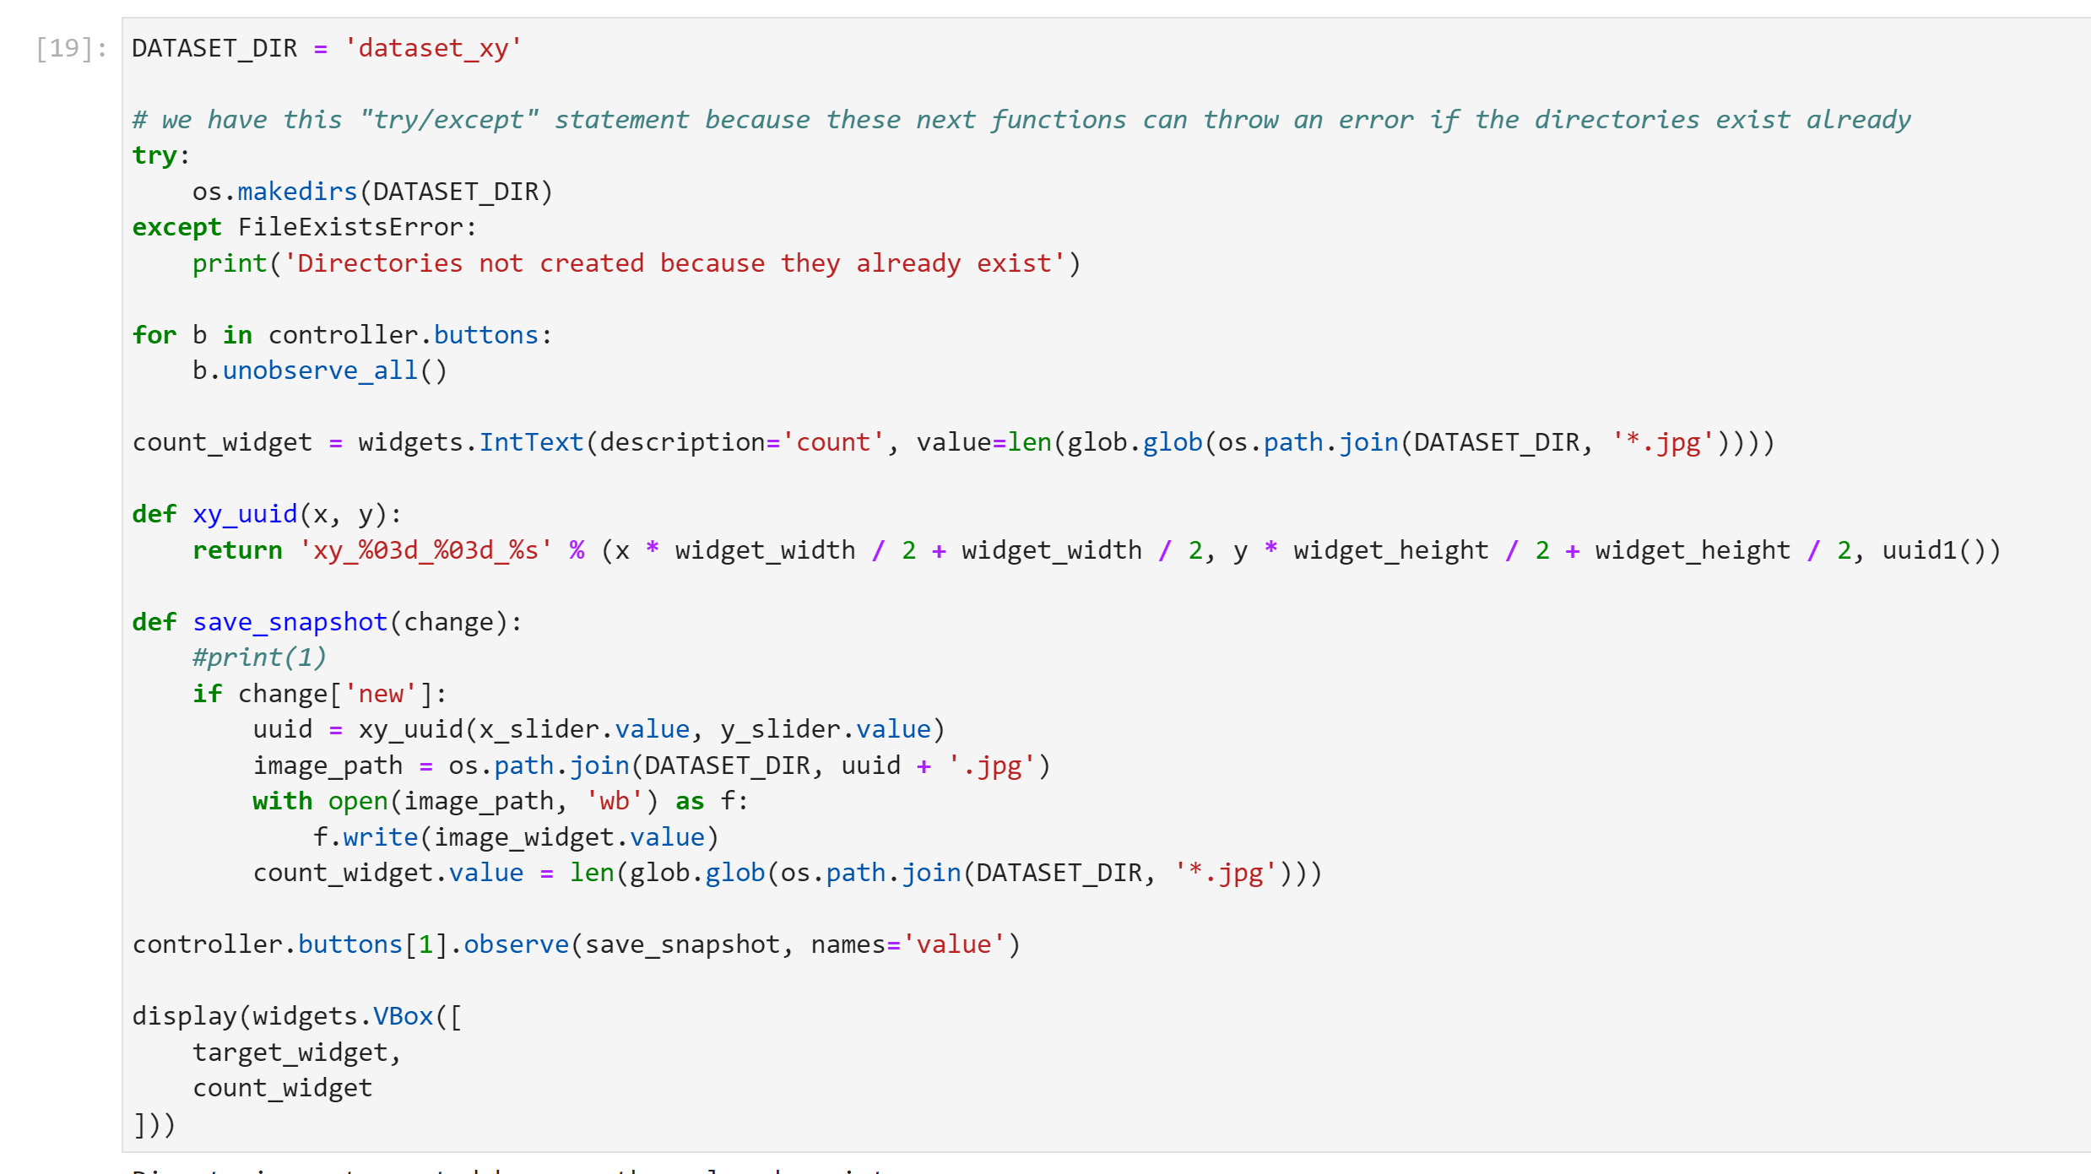

Slide 9
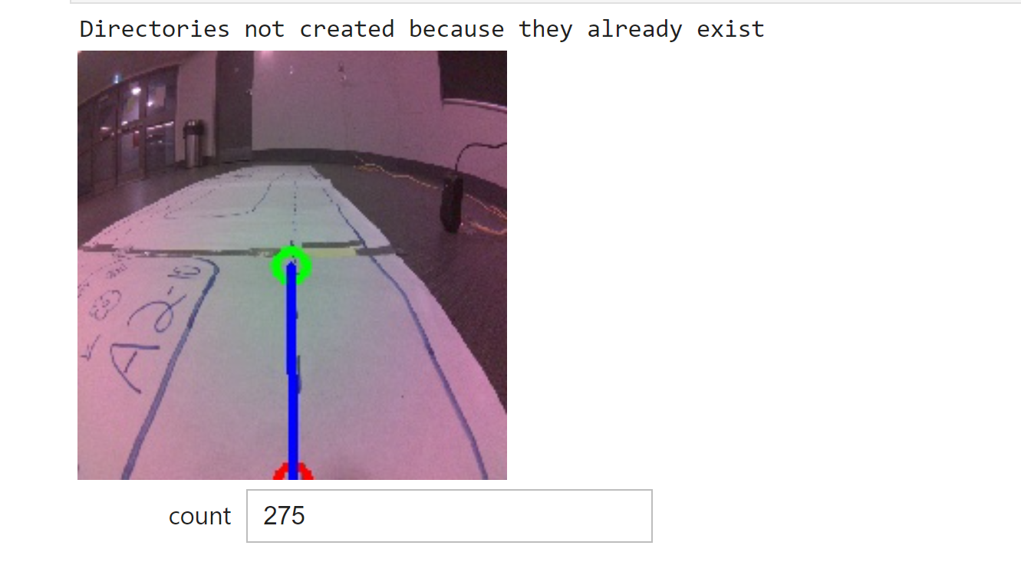

Slide 10
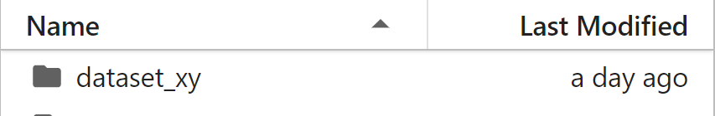
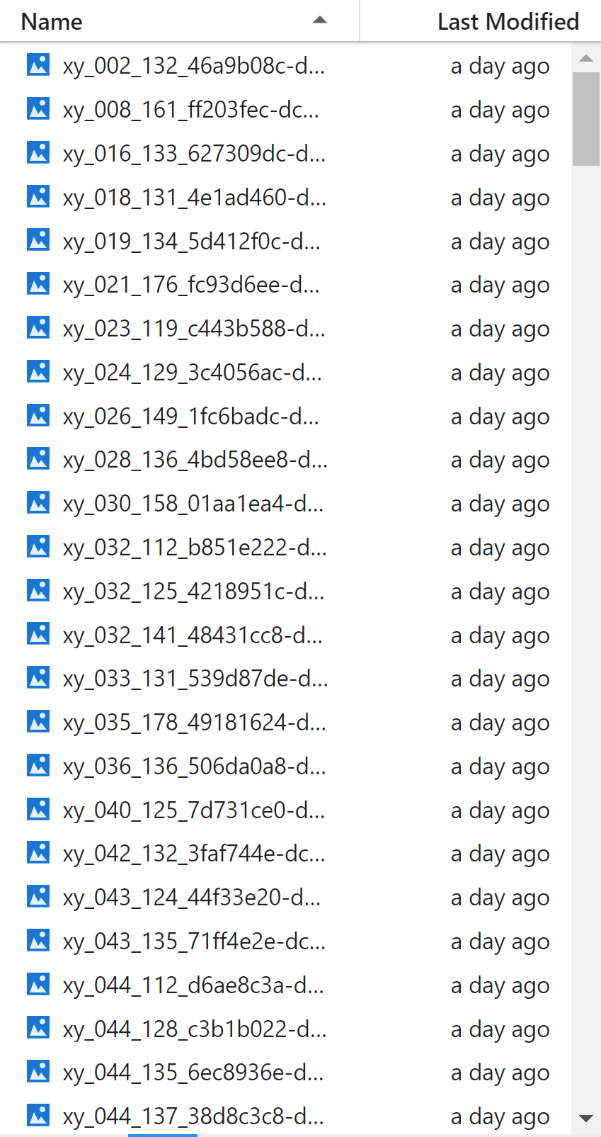
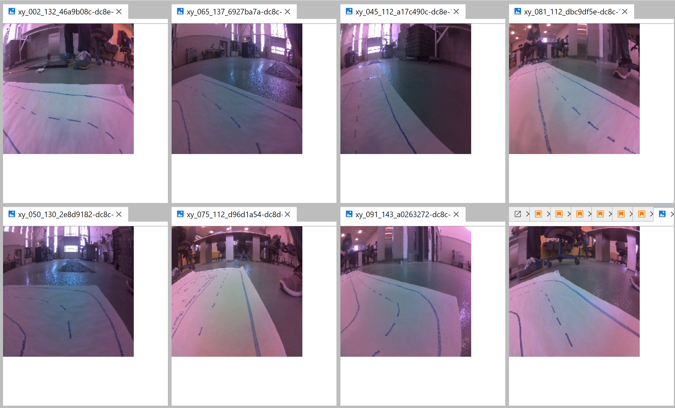
Road Following Data

Slide 11
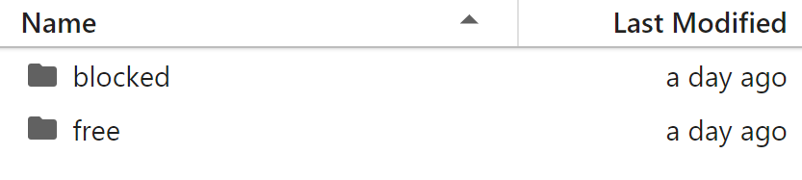
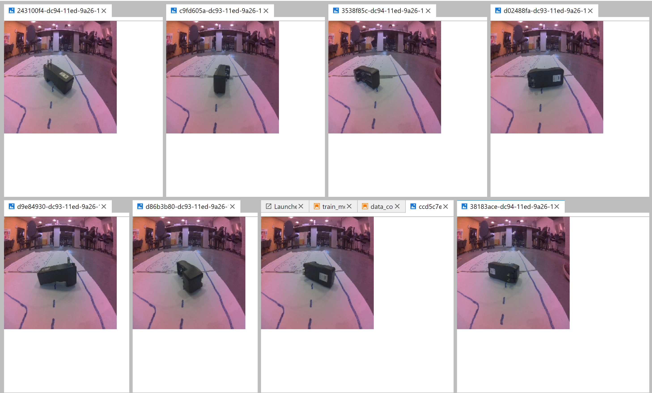
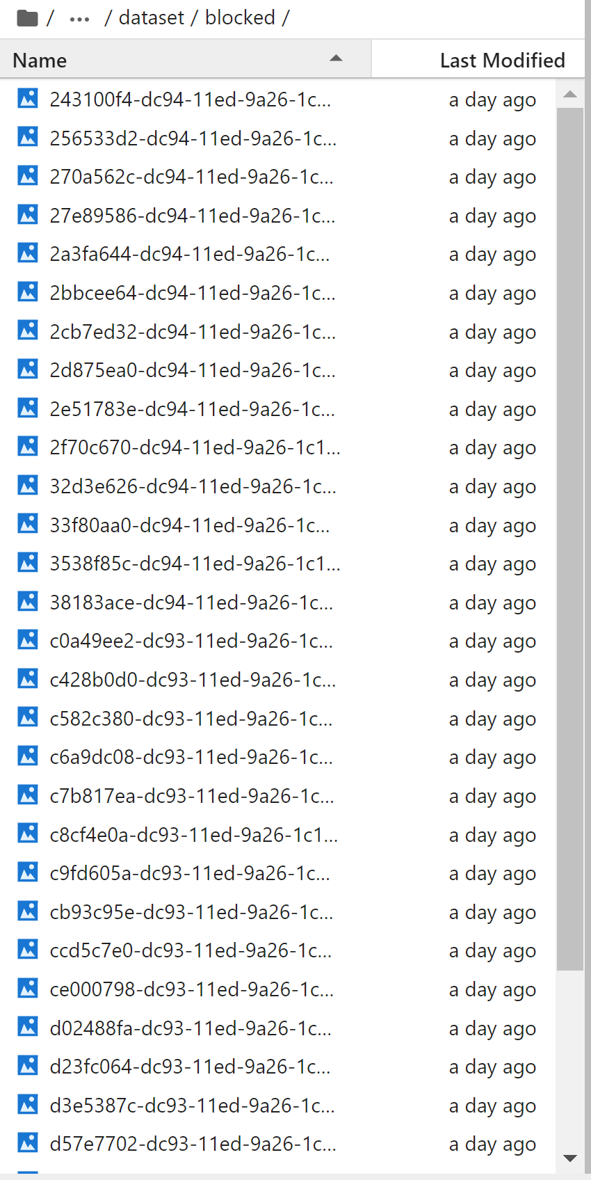
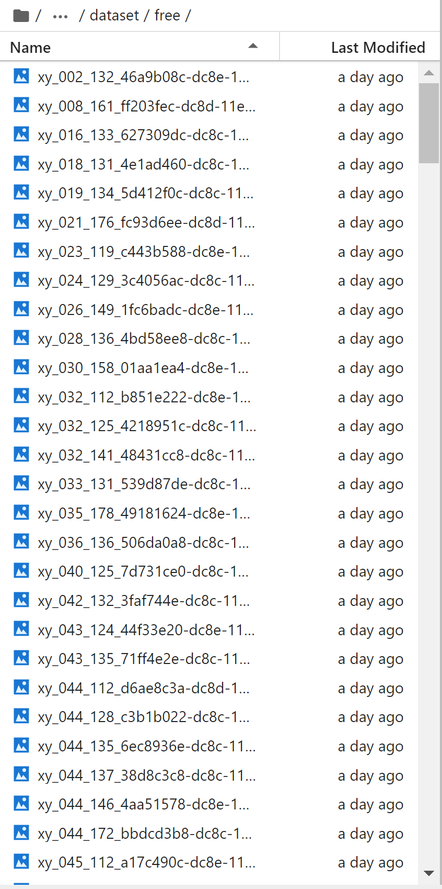
Blocked Data | Free Data
Blocked Data
Sample

Slide 12
Jetbot Training Steps
Jetbot training -Road Following
Jetbot training-Collision Avoidance

Slide 13
Jetbot training -Road Following
Download and extract data: To begin, you need to download and extract the dataset created in the data_collection.ipynb notebook. This dataset should contain images and corresponding labels (x and y values).
Create Dataset Instance: After downloading and extracting the dataset, you need to create a custom PyTorch dataset that loads images and parses x, y values from the image filenames. This involves writing a custom class that inherits from the PyTorch Dataset class and implements the getitem and len methods. You can then apply any necessary transformations to the data, such as color jitter and random horizontal flips, to augment the dataset and make it more robust to variations in the data.
Split dataset into train and test sets: Once you have created the custom dataset, you need to split it into a training set and a test set. In this example, the split is 90%-10%. This can be accomplished using the train_test_split function from the scikit-learn library.
Create data loaders to load data in batches: Next, you need to create data loaders to load data in batches. This can be done using the DataLoader class from PyTorch. It is recommended to shuffle the data and allow for multi-subprocesses to speed up the loading process. In this example, a batch size of 8 is used.

Slide 14
Jetbot training -Road Following
5.Define Neural Network Model: After creating data loaders, you need to define the neural network model. In this example, the ResNet-18 model available in PyTorch TorchVision is used. You will need to repurpose the pre-trained model for regression, since the problem at hand is a regression problem. You can then transfer the model for execution on the GPU to speed up the training process.​
6.Train Regression: With the data loaders and neural network model defined, you can now begin training the model for 70 epochs. During training, the Adam optimizer is used. It is important to save the best model if the loss is reduced, so that you can use it for inference later.

Slide 15
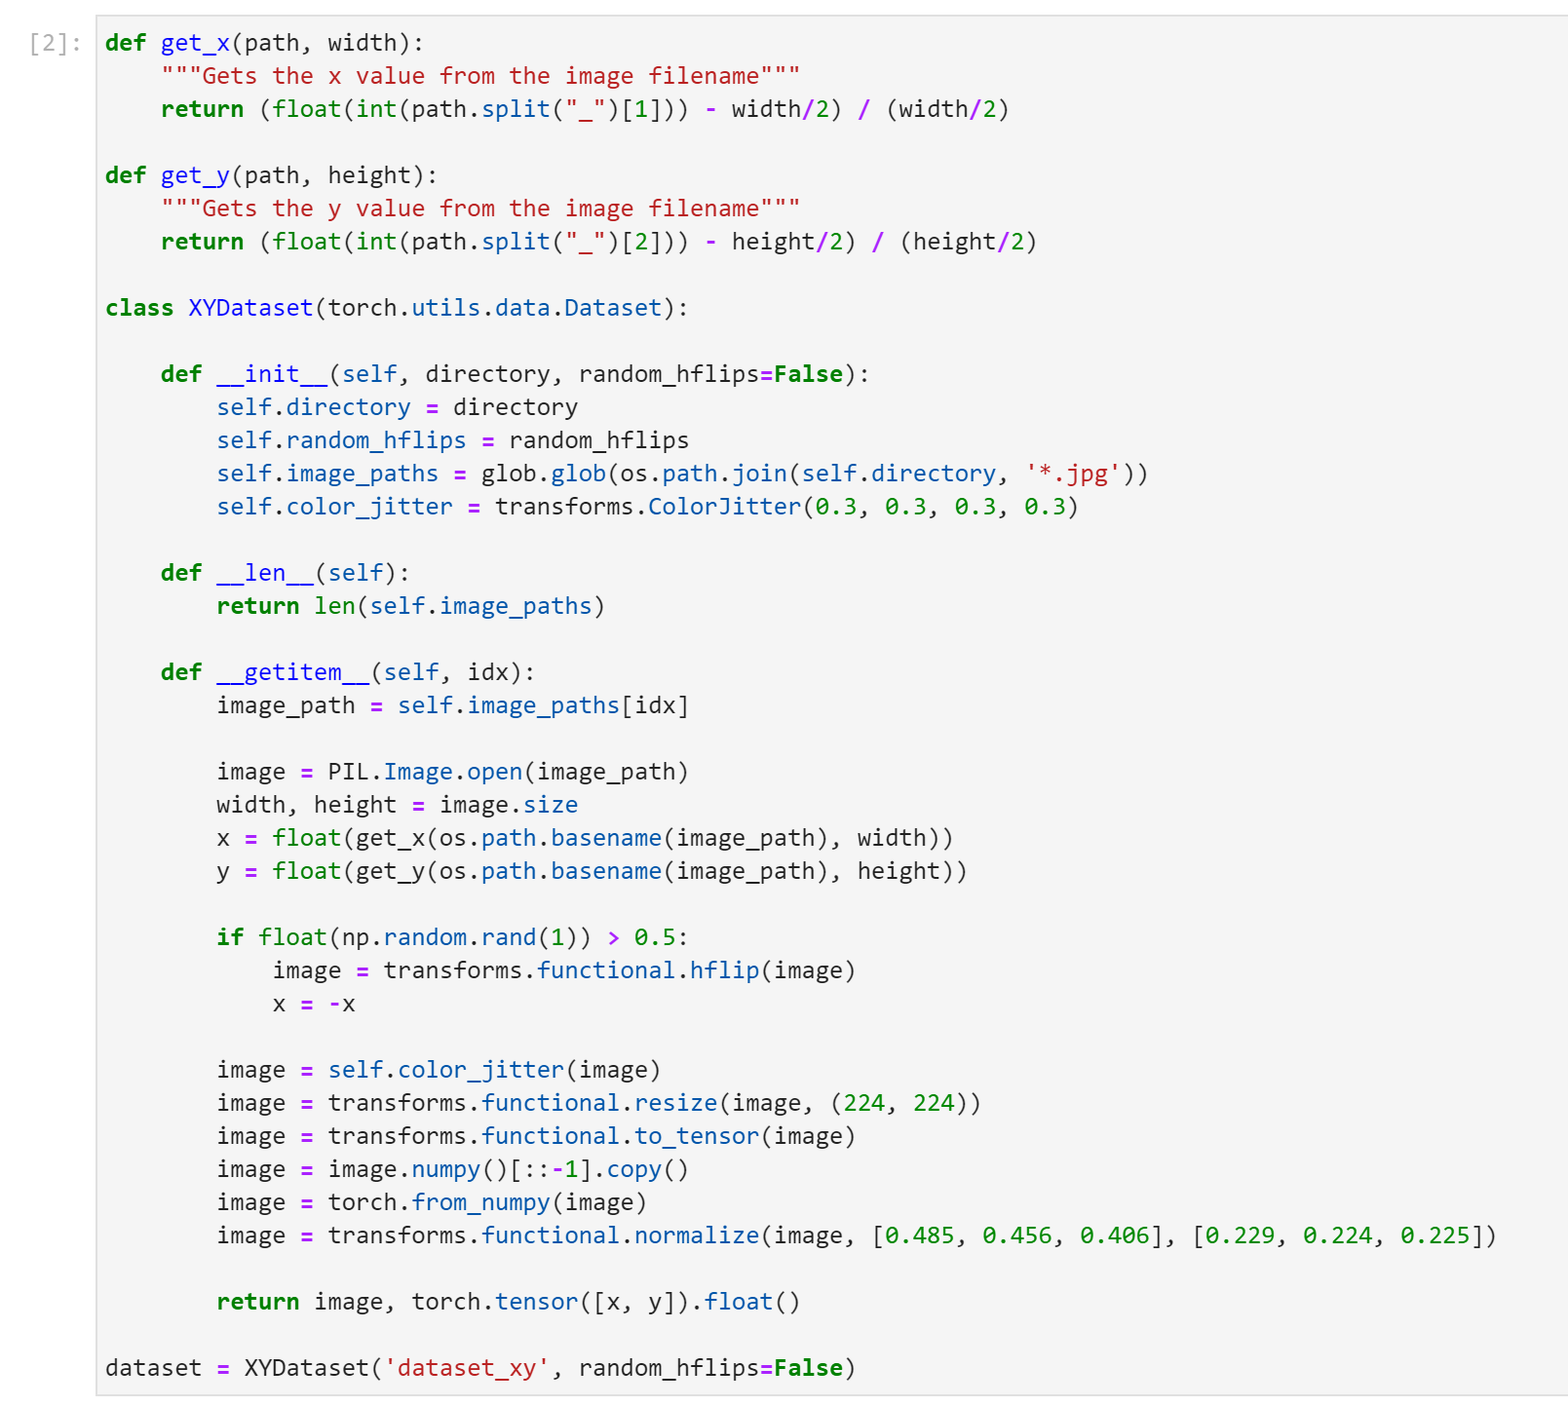
Jetbot Training - Road Following

Slide 16
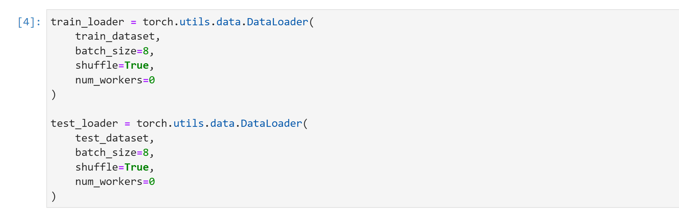
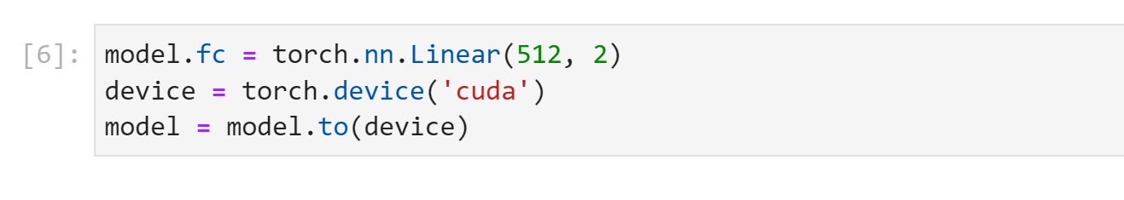
Jetbot Training - Road Following

Slide 17
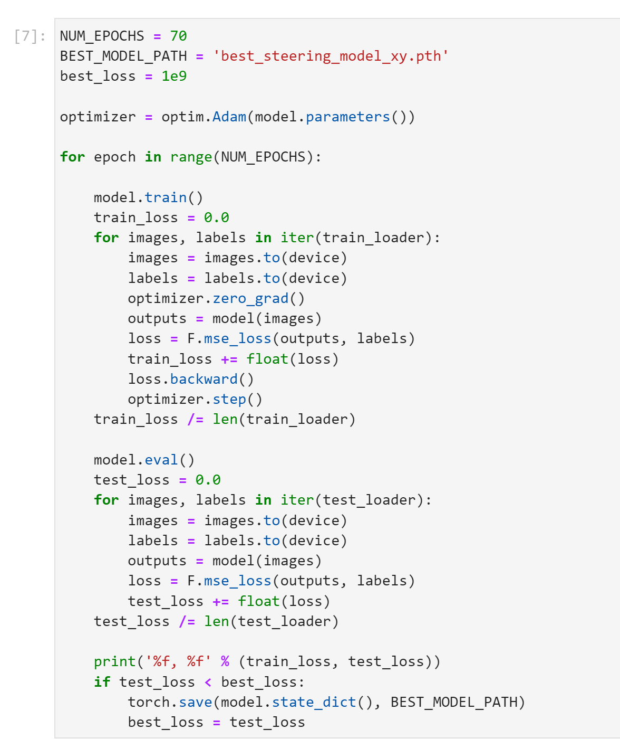
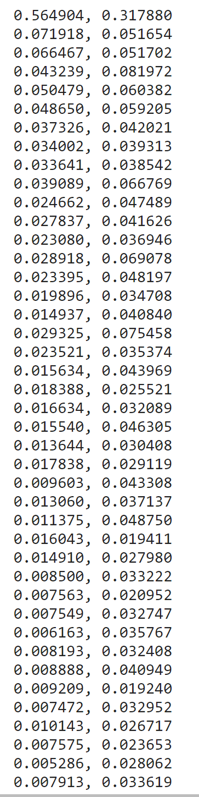
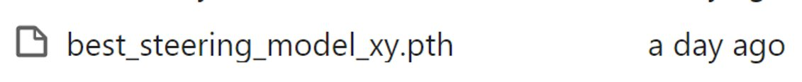
Jetbot Training - Road Following
Training Output
(Train Loss | Test Loss)

Slide 18
Jetbot training-Collision Avoidance
Upload and Extract Dataset :Before starting the training process, the dataset.zip file that was created in the data_collection.ipynb notebook on the robot should be uploaded. Then the dataset should be extracted using the command "!unzip -q dataset.zip". This will create a folder named dataset in the file browser.
Create Dataset Instance :The ImageFolder dataset class available with the torchvision.datasets package is used to create a dataset instance. The torchvision.transforms package is attached to transform the data for training. The transforms include ColorJitter, Resize, ToTensor, and Normalize.
Split Dataset into Train and Test Sets: The dataset is split into training and test sets using the torch.utils.data.random_split function. The test set will be used to verify the accuracy of the trained model.
Create Data Loaders to Load Data in Batches: Two DataLoader instances are created, one for the training set and the other for the test set. These DataLoader instances provide utilities for shuffling data, producing batches of images, and loading the samples in parallel with multiple workers.
Define the Neural Network :The neural network that will be trained is defined using the alexnet model provided by the torchvision package. The final layer of the pre-trained model is replaced with a new untrained layer that has only two outputs corresponding to the two classes in the dataset.

Slide 19
Jetbot training-Collision Avoidance
6.Transfer Model for Execution on GPU :The model is transferred for execution on the GPU using the device=torch.device('cuda') command.
7.Train the Neural Network :The neural network is trained for 30 epochs using the code provided. In each epoch, the optimizer is used to calculate the loss, and the model is updated with the backpropagation algorithm. The best performing model is saved after each epoch. The accuracy of the model is also printed at the end of each epoch.
8.Download the Model :After the training is completed, a file named best_model.pth will be created in the Jupyter Lab file browser. This file should be downloaded by right-clicking and selecting Download to download the model to the workstation.

Slide 20
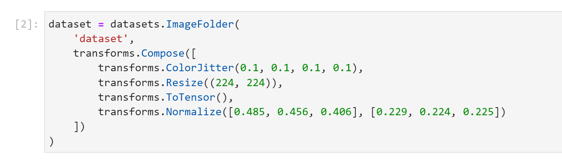
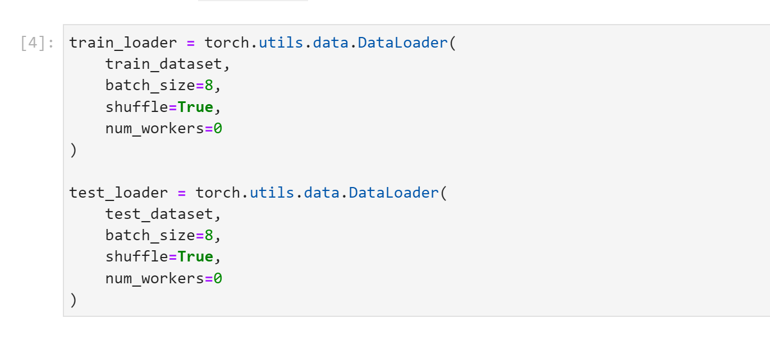
Jetbot Training - Collision Avoidance

Slide 21
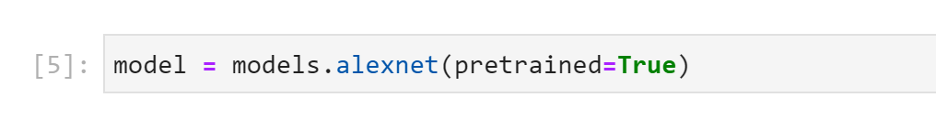
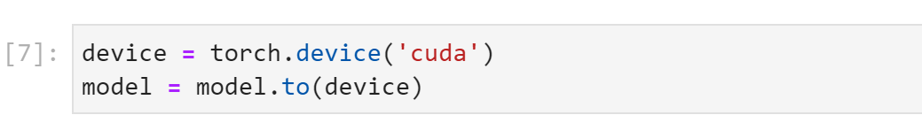
Jetbot Training - Collision Avoidance

Slide 22
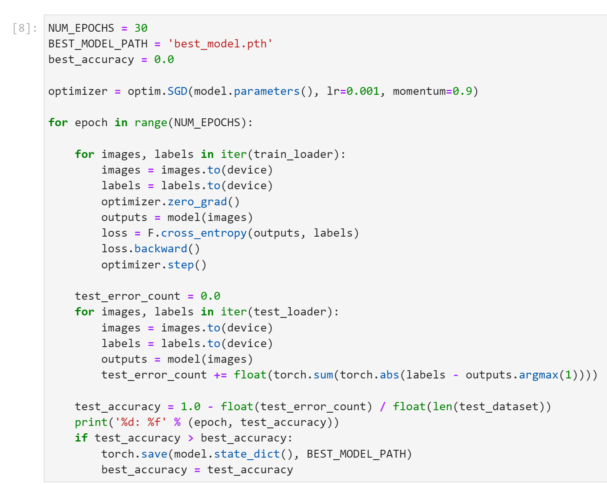
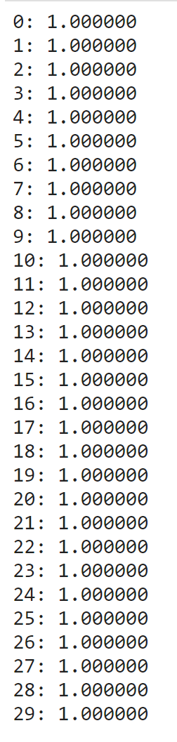
Jetbot Training - Collision Avoidance
Training Output
(Epoch | Test Accuracy)

Slide 23
Jetbot in Action
Running the training algorithm

Slide 24
Jetbot training: .
Transfer device from CPU memory to the GPU device: In order to use the GPU for faster computations, we need to transfer the device from CPU memory to the GPU device..
Load the optimized TRT models for road following and collision avoidance: We need to load the well-trained models for both road following and collision avoidance into our notebook. These models are already optimized for use with TensorRT (TRT) for faster inference times.
Define the pre-processing function: Since the format of the camera output doesn't match the format required by the neural network models, we need to define a pre-processing function to convert the image data to the correct format. This involves converting from HWC layout to CHW layout, normalizing using the same parameters as during training, transferring the data from CPU memory to GPU memory, and adding a batch dimension.
Display the camera output: We'll use the JetBot Camera class to display the camera output in our notebook.
Define sliders to control the JetBot: We can use sliders to control various aspects of the JetBot's behavior, such as speed control, steering gain, steering bias, etc.
Implement road following behavior: We'll use the well-trained road following model to implement the JetBot's road following behavior. This involves calculating the steering angle based on the output of the model and adjusting the motor speeds accordingly.
Implement collision avoidance behavior: We'll use the well-trained collision avoidance model to implement the JetBot's collision avoidance behavior. This involves detecting obstacles in the camera output and stopping the JetBot if an obstacle is detected
Combine road following and collision avoidance:Finally, we'll combine the road following and collision avoidance behaviors so that the JetBot can both follow the road and avoid obstacles at the same time.

Slide 25
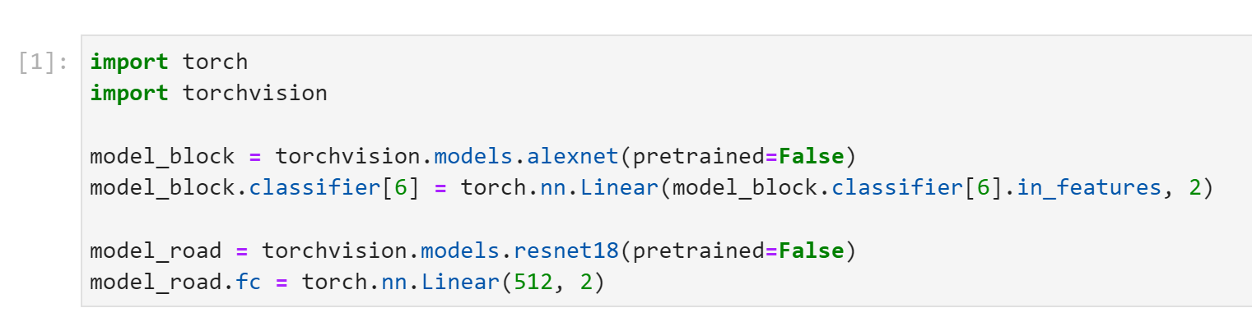
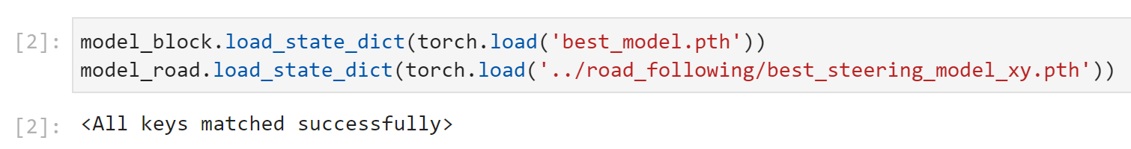
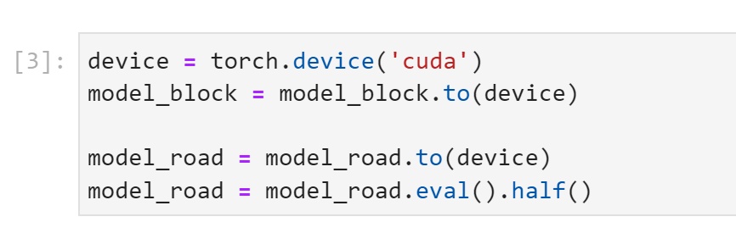
Load the trained model

Slide 26
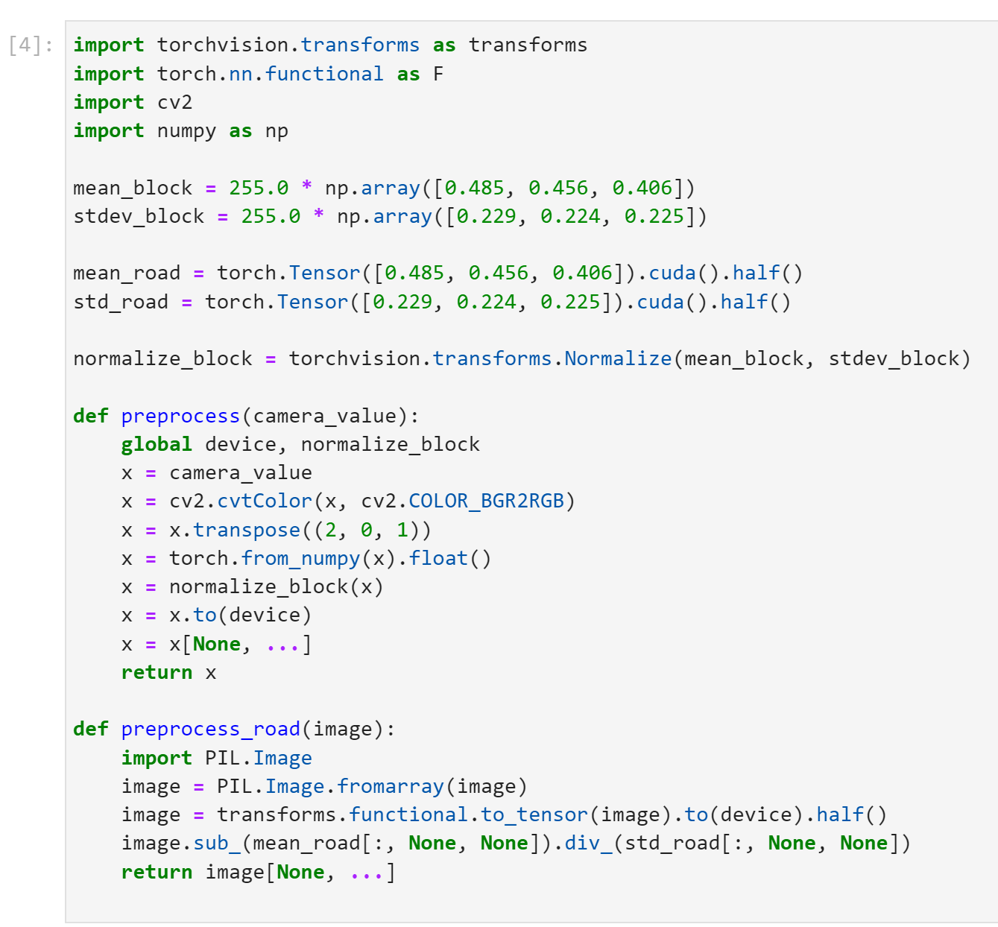
Create the Preprocessing Function

Slide 27
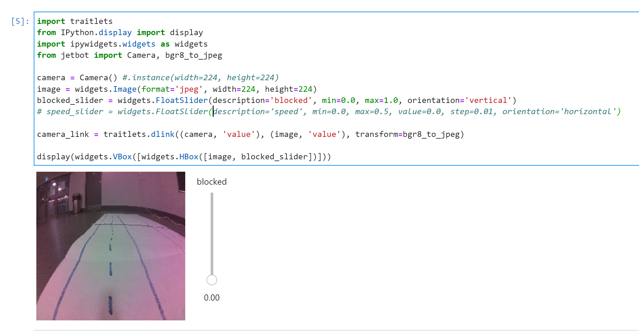
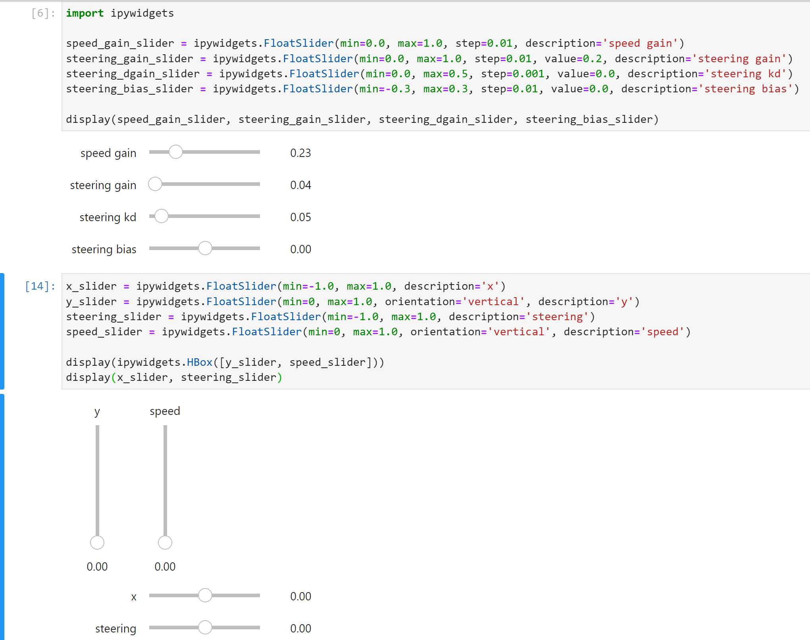
Control Slider

Slide 28
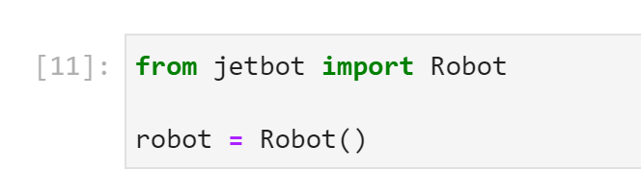
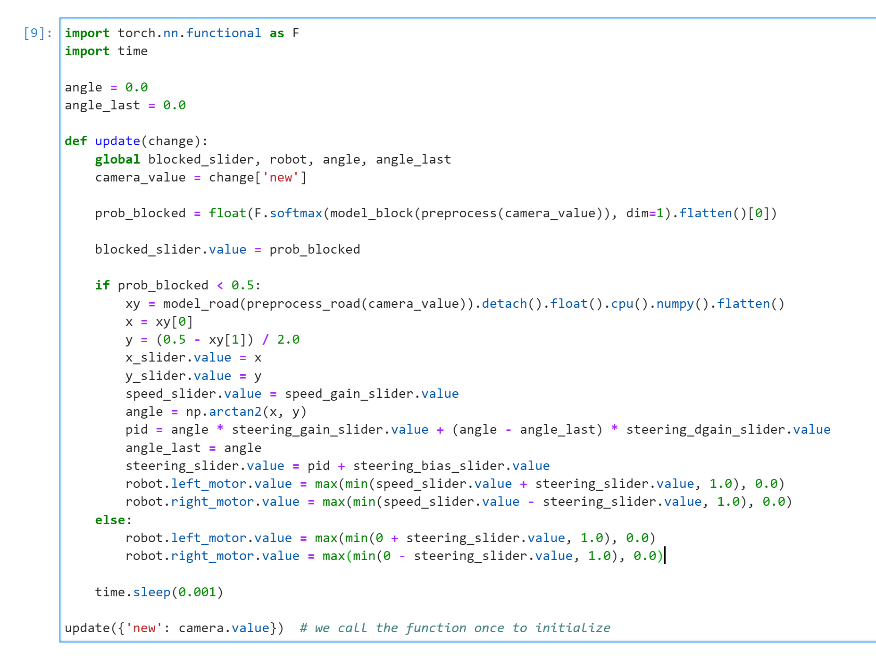
1. Pre-process the camera image
2. Execute the neural network
3. While the neural network output indicates we're blocked, it will stop, otherwise it goes forward.
Create Robot
Observe Function

Slide 29
DEMO Jetbot Training - Road Following

Slide 30
DEMO Jetbot Training - Collision Avoidance

Slide 31
Conclusion:
Challenges faced
Resolving Jetbot training issues
Ways to enhance Jetbot training performance

Slide 32
Challenges faced:
Hardware limitations: The Jetbot has hardware limitations such as processing power, memory, and battery life, which can limit its performance and training capabilities.
Data quality: The quality of the training data can greatly affect the performance of the Jetbot. If the data is noisy, inconsistent, or biased, it can lead to poor performance and inaccurate predictions.
Overfitting: Overfitting occurs when a machine learning model is trained too well on a particular set of data, to the point where it becomes too specialized and cannot generalize well to new data.
Hyperparameter tuning: Choosing the right hyperparameters for the machine learning model can be challenging, and often requires trial and error experimentation to find the optimal settings.
Real-world variability: Real-world environments can be unpredictable and have many variables that can affect the Jetbot's performance, such as changes in lighting conditions, weather, and obstacles.
Resolving Jetbot training issues:
Increase training data: Increasing the amount and quality of training data can help improve the Jetbot's performance. Data augmentation techniques such as flipping, rotating, and scaling the training data can also help increase the amount of data.
Regularization: Regularization techniques such as dropout and L2 regularization can help prevent overfitting by reducing the model's complexity and adding constraints.
Hyperparameter tuning: Experimenting with different hyperparameters such as learning rate, batch size, and optimizer can help improve the Jetbot's performance.
Transfer learning: Transfer learning involves using pre-trained models as a starting point for training the Jetbot. This can help reduce the amount of training data needed and improve performance.
Ensemble methods: Using ensemble methods such as bagging and boosting can help improve the Jetbot's performance by combining the predictions of multiple models.

Slide 33
Ways to enhance Jetbot training performance:
Collect high-quality training data: Collecting high-quality training data that accurately represents the real-world environment can greatly improve the Jetbot's performance.
Train on a variety of environments: Training the Jetbot on a variety of environments can help improve its ability to generalize and perform well in different conditions.
Use transfer learning: Using transfer learning can help speed up the training process and improve performance by using pre-trained models as a starting point.
Optimize hyperparameters: Optimizing hyperparameters such as learning rate, batch size, and optimizer can help improve the Jetbot's performance.
Use regularization techniques: Regularization techniques such as dropout and L2 regularization can help prevent overfitting and improve the Jetbot's ability to generalize.

Slide 34

Thank You
Dear Professor,
We would like to express our sincere gratitude for giving us the opportunity to present our Jetson Nano project. It has been an incredible learning experience for all of us, and we appreciate your guidance and support throughout the project.

